Slide 1

Bahirdar Institute of Technology
Faculity of Electrical and Computer Engineering
Internet Programming Project
Project Title: Online BookStore System.
BookStore name: Gion Book Store.
By: Natnael Berhanu and Kidus Tadesse.

Slide 2
Contents
1.Objectives
General Objective
Specific Objective
2 Triggering Problem
3. Methodology
4. Demonstration

Slide 3

Objective of the project
1.General Objectives
To Design an online bookstore named Gion Book Store that mainly sells Varity of books.
To Design such a system which one can say 'goodbye' to the days when He stood in line waiting, and waiting some more for a store clerk to finally check out His items.
To design online shopping system which has friendly customer service representatives available 24 hours a day, 7 days a week to assist customers with locating and purchasing Books.
To Design online shopping system in which Customers will be able to search or visit categories to find the books they want, check the availability, and place the order to buy the book using Bank and electronic Payment.

Slide 4
2.Specific Objectives
Identifying problems of the existing system.
Defining and Analyzing the problem identified in existing system.
Design interactive user interfaces for Gion Bookstore users.
Create a database to register users, and store personal profiles and system informations.
Design high level system architecture of online bookstore.

Slide 5
Problems That Trigger To Design Online Bookstore System
Almost every activity in the world today is controlled by computer driven software programs. As the life style became more and more advanced, every area of human interactions was invaded by various software systems, such as simulation, embedded, web based, and more recently, artificial intelligence software etc.
According to the above facts, managing and maintaining a book store could also be controlled by efficient software. This project focuses attention on designing efficient and reliable software
Which controls the customer service and transactions of a bookstore.
.

Slide 6
In real world, it tends to associate with automated systems as they provide many benefits than doing the same thing in manually. As above mentioned, here we have introduced a system which can be used to maintain a bookshop.When we are concerning the manual process of a bookshop, the major problem is the waste of time. A customer has to waste his/her valuable time when he needs to buy a book as all the events such as searching, purchasing are done by members of the staff .In briefly, the manual process is very slow.
But automation will reduce the time taken in the whole process. In a bookshop we should deal with a large store. Communication with suppliers, customers and When the bookshop issues an item to a customer, all the stages of the transaction procedure will be facilitated by the system & it will be more accurate and be more successful as the system is so fast.

Slide 7
Design and Methodology
In this project, several technical approaches are used:
  HTML language for WebPages design and implementation.
My SQL for reational database system.
  PHP for database connection.
SQL, structured Query language is used to access and manipulate database.
Java Script technology for client-server communication.

Slide 8
Graphical Representation Of Bookstore System
user interface
command
result
control function
Search,update
retrive
Local Database
product tables
message tables
tacart ble
user table
order table

Slide 9
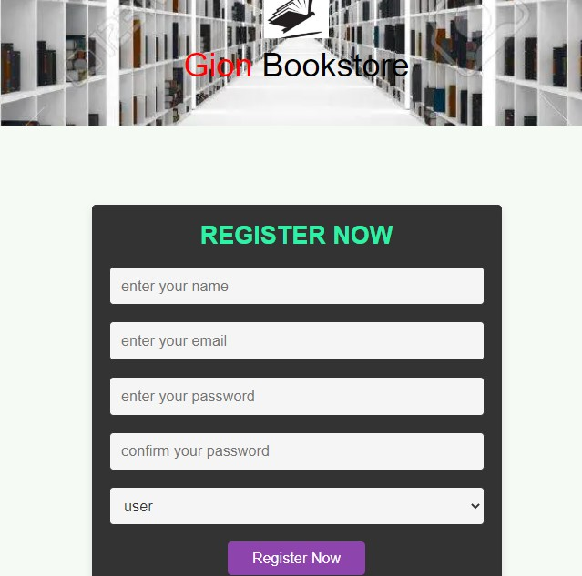
Demonstration
A. User Registration Form

Slide 10
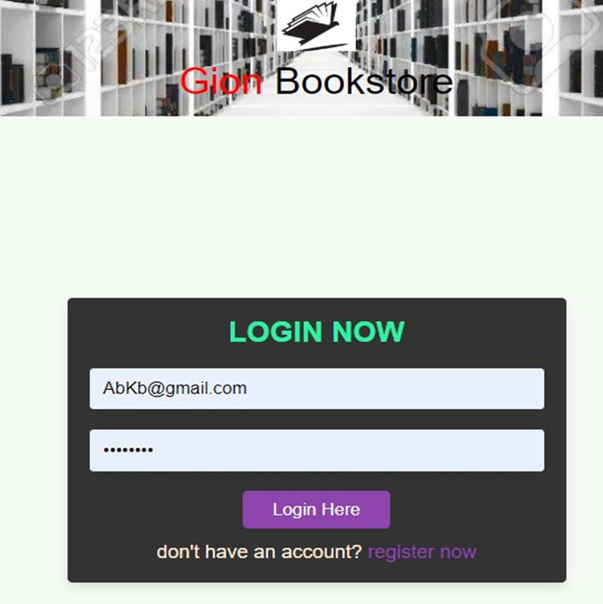
B. Login Form

Slide 11

C. Home page

Slide 12
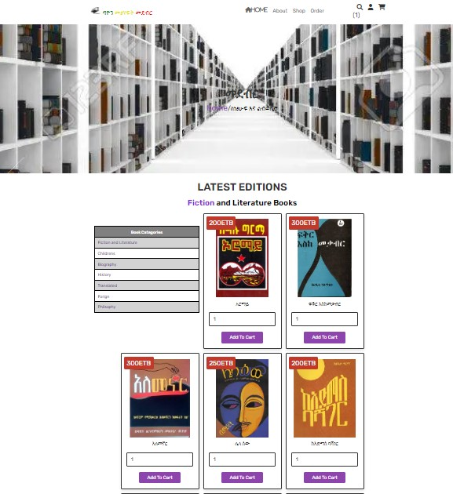
D. shop page

Slide 13
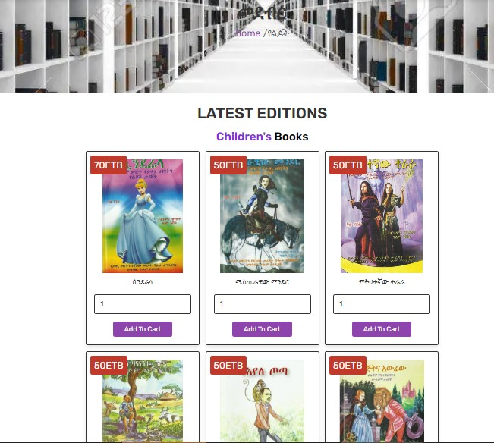
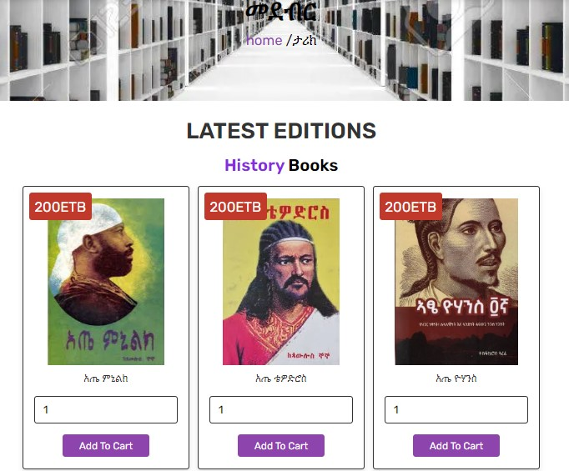
D. sample categories

Slide 14
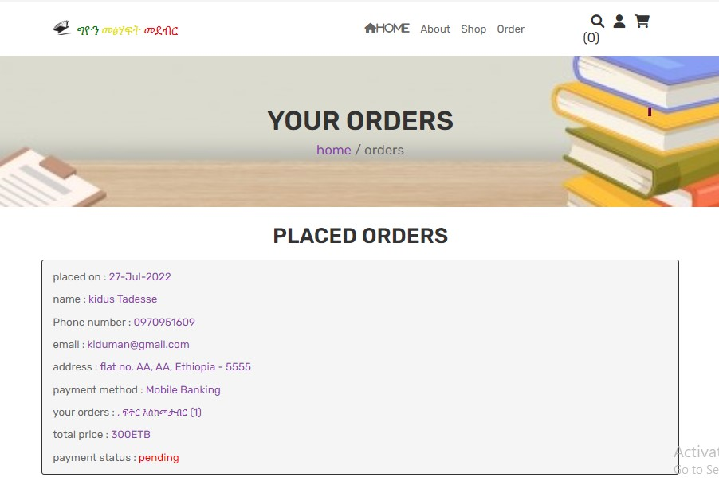
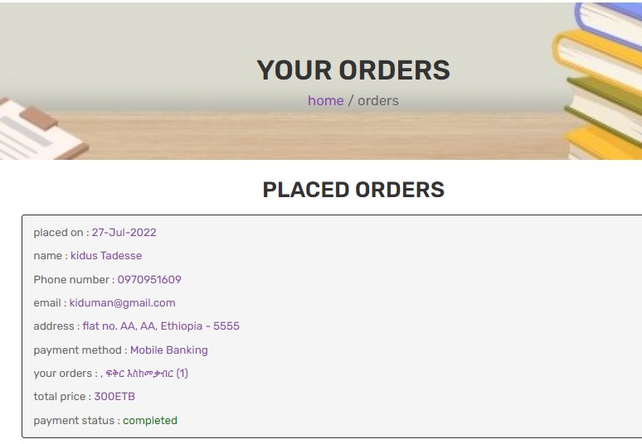
E .Order Page

Slide 15
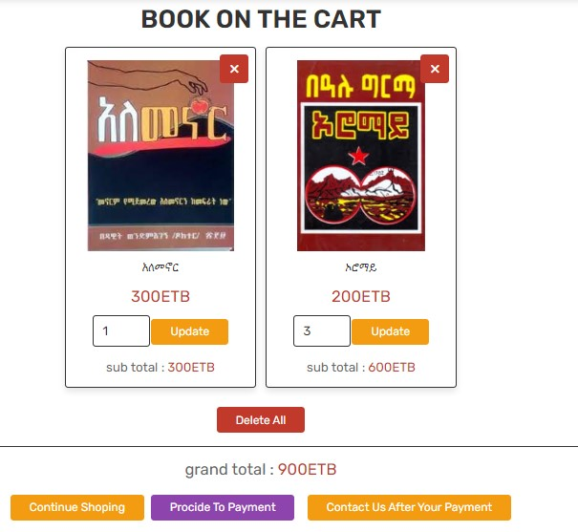
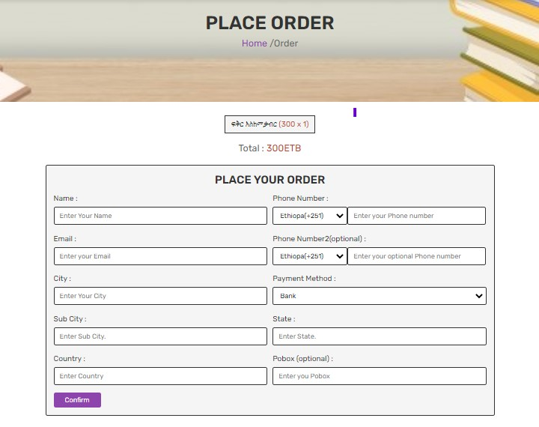
D. Cart and Payment Page.

Slide 16
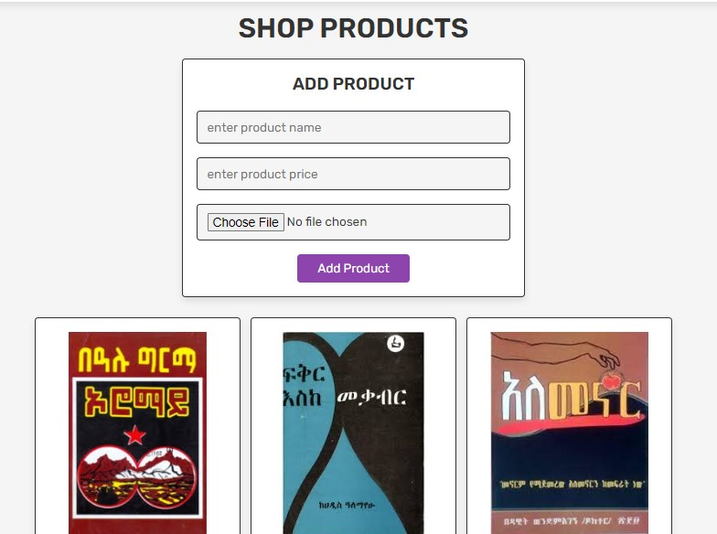
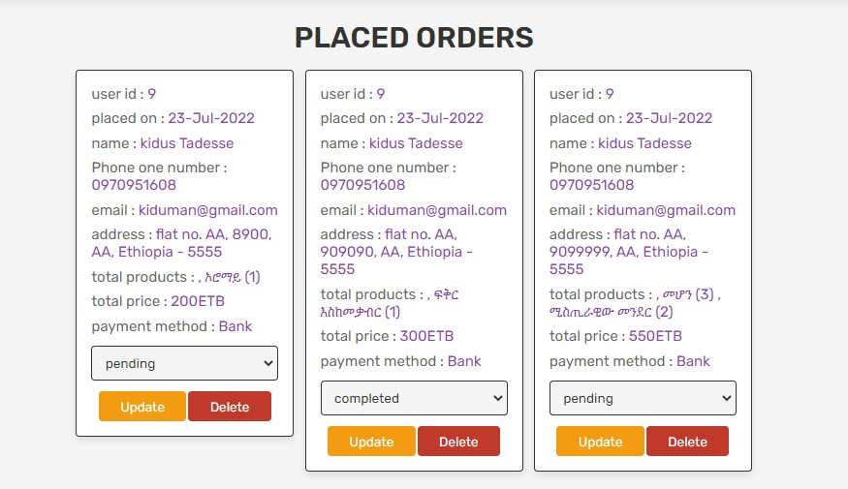
E. Admin

Slide 17
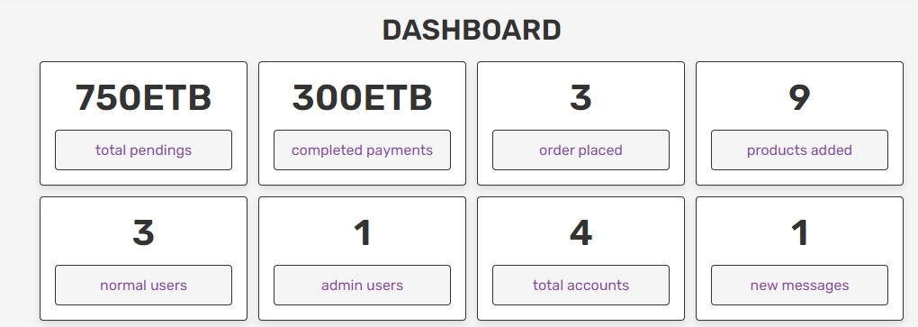
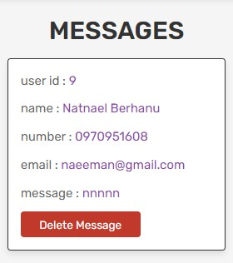
E. Admin

Slide 18
ሃገር ያለአንድነት ህሊና ያለንባብ አይበልፅግም!

Slide 19

Team Presentation
KIDUS TADESSE
NATNAEL BIRHANU

